Slide 1
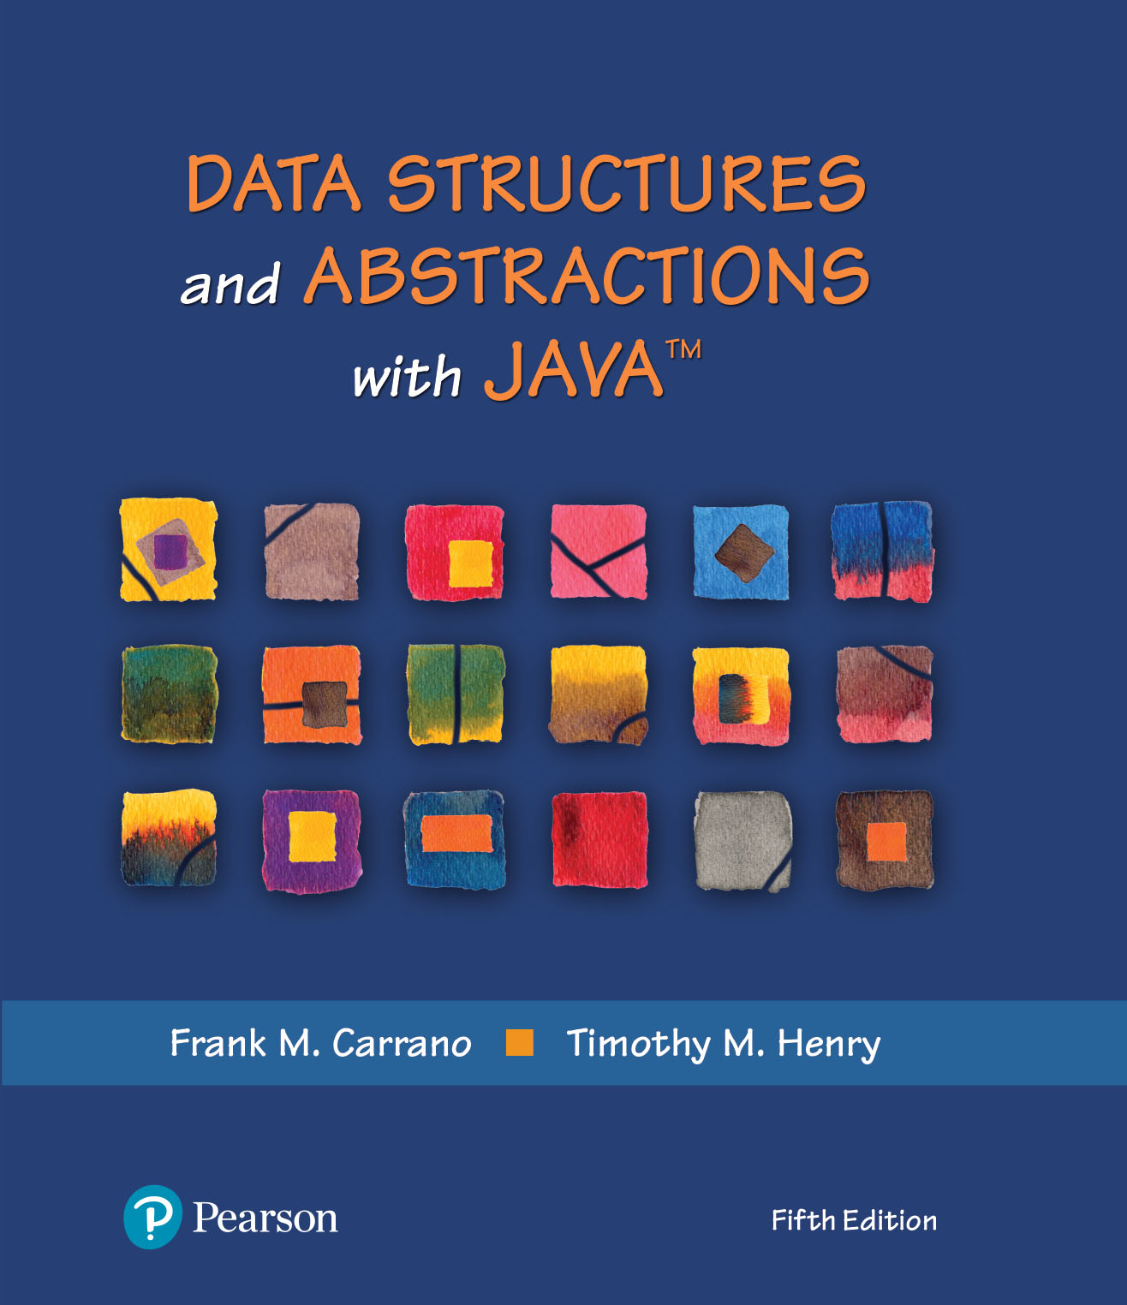
Data Structures and Abstractions with Java™
5th Edition
Module 8 - Queues
Including:
Chapter 7 - Queues, Deques, and Priority Queues
Chapter 8 - Queue, Deque, and Priority Queue Implementations

Slide 2
The ADT Queue
A queue is another name for a waiting line
Used within operating systems and to simulate real-world events
Come into play whenever processes or events must wait
Entries organized first-in, first-out

Slide 3
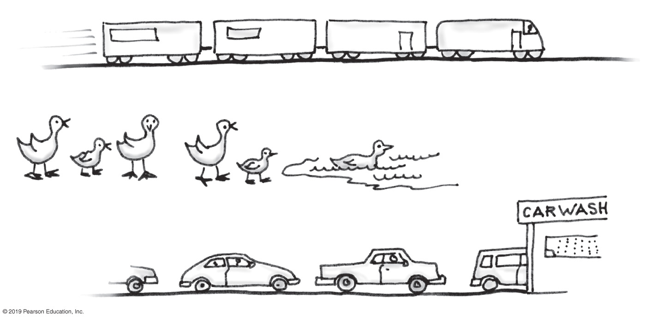
The ADT Queue
FIGURE 7-1 Some everyday queues

Slide 4
The ADT Queue
Terminology
Item added first, or earliest, is at the front of the queue
Item added most recently is at the back of the queue
Additions to a software queue must occur at its back
Client can look at or remove only the entry at the front of the queue

Slide 5
The ADT Queue
Data
A collection of objects in chronological order and having the same data type
Pseudocode | UML | Description
enqueue(newEntry) | +enqueue(newEntry: integer): void | Task: Adds a new entry to the back of the queue. Input: newEntry is the new entry. Output: None.
dequeue() | +dequeue(): T | Task: Removes and returns the entry at the front of the queue. Input: None. Output: Returns the queue’s front entry. Throws an exception if the queue is empty before the operation.
getFront() | +getFront(): T | Task: Retrieves the queue’s front entry without changing the queue in any way. Input: None. Output: Returns the queue’s front entry. Throws an exception if the queue is empty.
isEmpty() | +isEmpty(): boolean | Task: Detects whether the queue is empty. Input: None. Output: Returns true if the queue is empty.
clear() | +clear(): void | Task: Removes all entries from the queue. Input: None. Output: None.

Slide 6
The ADT Queue
/** An interface for the ADT queue. */
public interface QueueInterface<T>
{
/** Adds a new entry to the back of this queue.
@param newEntry An object to be added. */
public void enqueue(T newEntry);
/** Removes and returns the entry at the front of this queue.
@return The object at the front of the queue.
@throws EmptyQueueException if the queue is empty before the operation. */
public T dequeue();
/** Retrieves the entry at the front of this queue.
@return The object at the front of the queue.
@throws EmptyQueueException if the queue is empty. */
public T getFront();
/** Detects whether this queue is empty.
@return True if the queue is empty, or false otherwise. */
public boolean isEmpty();
/** Removes all entries from this queue. */
public void clear();
} // end QueueInterface
LISTING 7-1 An interface for the ADT queue

Slide 7
FIGURE 7-2 The effect of operations on a queue of strings

Slide 8
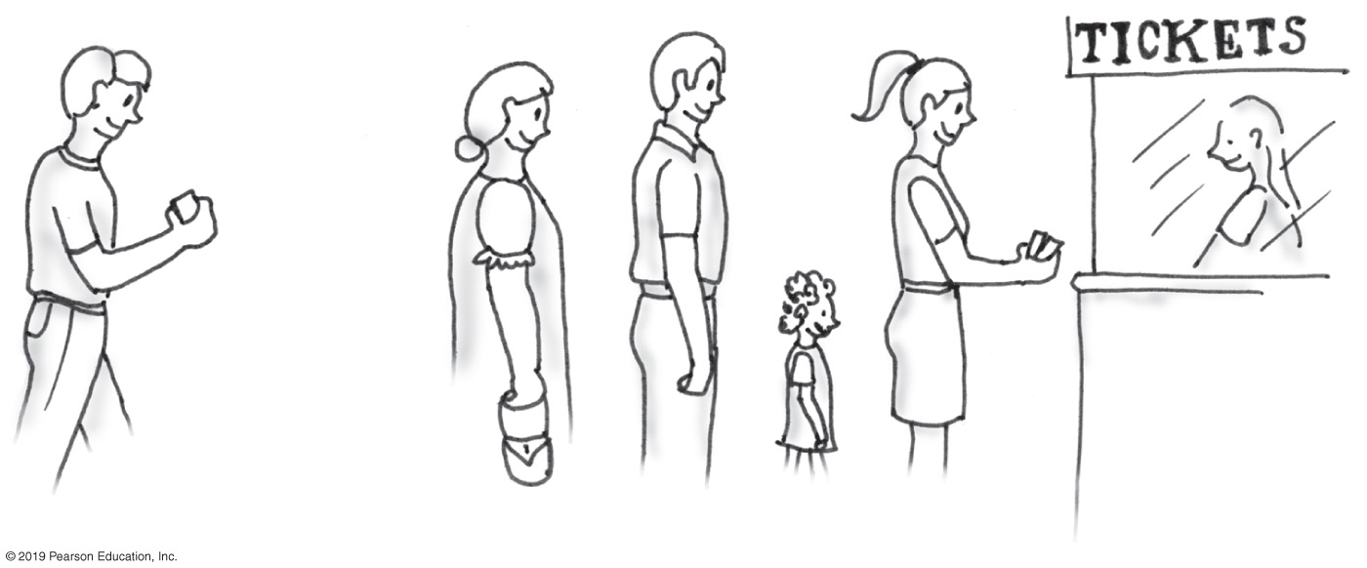
Simulating a Waiting Line
FIGURE 7-3 A line, or queue, of people

Slide 9
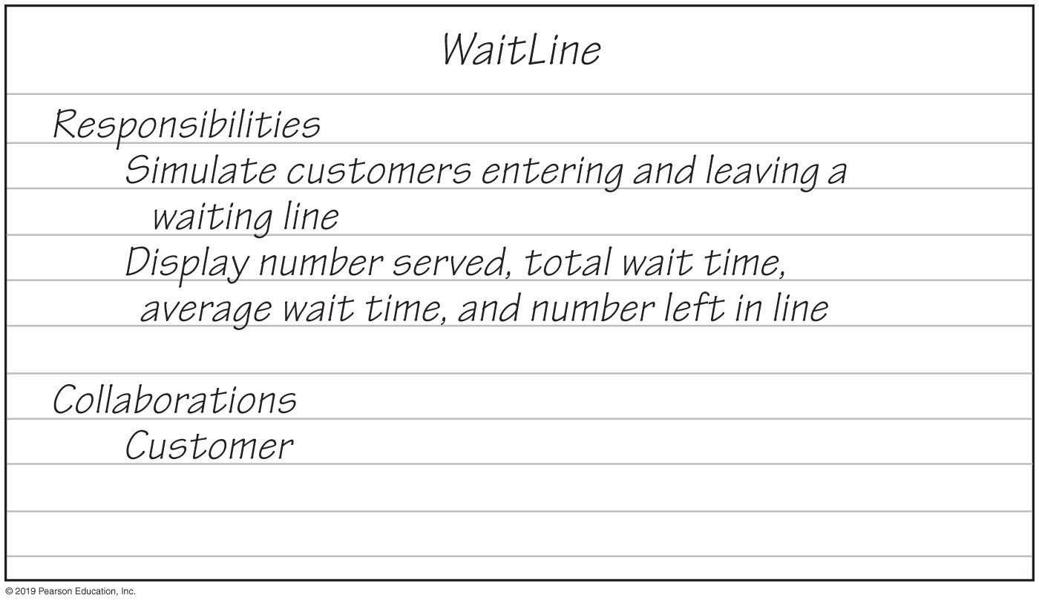
Simulating a Waiting Line
WaitLine
Responsibilities
Simulate customers entering and leaving a
waiting line
Display number served, total wait time,
average wait time, and number left in line
Collaborations
Customer
FIGURE 7-4 A CRC card for the class WaitLine

Slide 10
Simulating a Waiting Line
WaitLine
line—a queue of customers numberOfArrivals—number of customers numberServed—number of customers actually served totalTimeWaited—total time customers have waited
simulate(duration, arrivalProbability, maxTransactionTime) displayResults()
1
Customer
arrivalTime transactionTime customerNumber
getArrivalTime() getTransactionTime() getCustomerNumber()
*
FIGURE 7-5 A diagram of the classes WaitLine and Customer

Slide 11
Simulating a Waiting Line
Algorithm simulate(duration, arrivalProbability, maxTransactionTime)
transactionTimeLeft = 0
for (clock = 0; clock < duration; clock++)
{
if (a new customer arrives)
{
numberOfArrivals++
transactionTime = a random time that does not exceed maxTransactionTime
nextArrival = a new customer containing clock, transactionTime, and
a customer number that is numberOfArrivals
line.enqueue(nextArrival)
}
if (transactionTimeLeft > 0) // If present customer is still being served
transactionTimeLeft−−
else if (!line.isEmpty())
{
nextCustomer = line.dequeue()
transactionTimeLeft = nextCustomer.getTransactionTime() − 1
timeWaited = clock − nextCustomer.getArrivalTime()
totalTimeWaited = totalTimeWaited + timeWaited numberServed++
}
}
Algorithm for simulate

Slide 12
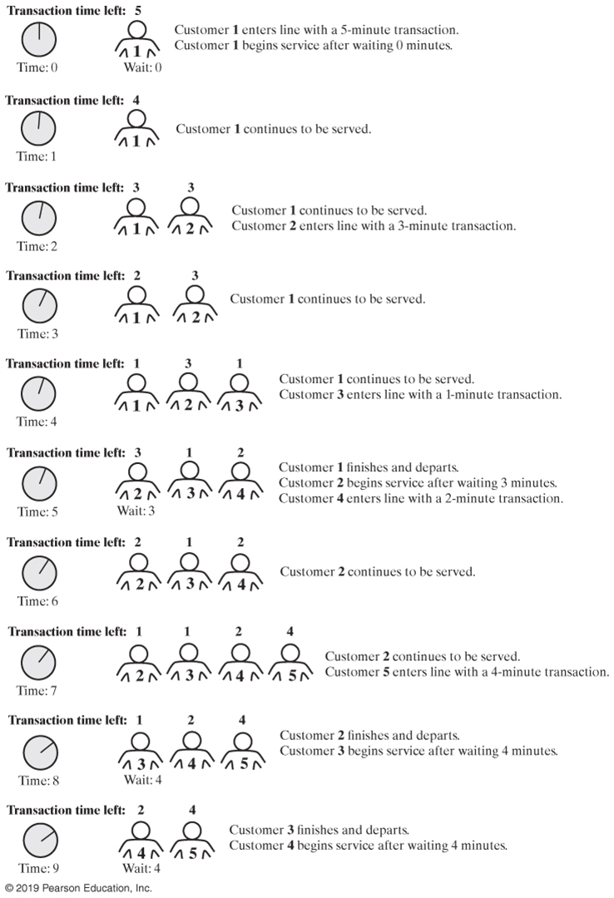
Simulating a Waiting Line (Part 1)
FIGURE 7-6 A simulated waiting line

Slide 13
Simulating a Waiting Line (Part 2)
FIGURE 7-6 A simulated waiting line

Slide 14
Simulating a Waiting Line
/** Simulates a waiting line. */
public class WaitLine
{
private QueueInterface<Customer> line;
private int numberOfArrivals;
private int numberServed;
private int totalTimeWaited;
public WaitLine()
{
line = new LinkedQueue<>();
reset();
} // end default constructor
/** Initializes the simulation. */
public final void reset()
{
line.clear();
numberOfArrivals = 0;
numberServed = 0;
totalTimeWaited = 0;
} // end reset
public void simulate(int duration, double arrivalProbability,
int maxTransactionTime)
{ < implementation on next slide > }
public void displayResults()
{ < implementation on next slide > }
} // end WaitLine
LISTING 7-2 The class WaitLine

Slide 15
Simulating a Waiting Line
public void simulate(int duration, double arrivalProbability, int maxTransactionTime)
{
int transactionTimeLeft = 0;
for (int clock = 0; clock < duration; clock++)
{
if (Math.random() < arrivalProbability)
{
numberOfArrivals++;
int transactionTime = (int)(Math.random() * maxTransactionTime + 1);
Customer nextArrival = new Customer(clock, transactionTime,
numberOfArrivals);
line.enqueue(nextArrival);
System.out.println("Customer " + numberOfArrivals +
" enters line at time " + clock +
". Transaction time is " + transactionTime);
} // end if
if (transactionTimeLeft > 0)
transactionTimeLeft--;
else if (!line.isEmpty())
{
Customer nextCustomer = line.dequeue();
transactionTimeLeft = nextCustomer.getTransactionTime() - 1;
int timeWaited = clock - nextCustomer.getArrivalTime();
totalTimeWaited = totalTimeWaited + timeWaited;
numberServed++;
System.out.println("Customer " + nextCustomer.getCustomerNumber() +
" begins service at time " + clock +
". Time waited is " + timeWaited);
} // end if
} // end for
} // end simulate

Slide 16
Simulating a Waiting Line
/** Displays summary results of the simulation. */
public void displayResults()
{
System.out.println();
System.out.println("Number served = " + numberServed);
System.out.println("Total time waited = " + totalTimeWaited);
double averageTimeWaited = ((double)totalTimeWaited) / numberServed;
System.out.println("Average time waited = " + averageTimeWaited);
int leftInLine = numberOfArrivals - numberServed;
System.out.println("Number left in line = " + leftInLine);
} // end displayResults

Slide 17
Computing the Capital Gain in a Sale of Stock
StockLedger
Responsibilities
Record the shares of a stock purchased,
in chronological order
Remove the shares of a stock sold,
beginning with the ones held the longest
Compute the capital gain (loss) on shares of a
stock sold
Collaborations
Share of stock
FIGURE 7-7 A CRC card for the class StockLedger

Slide 18
Computing the Capital Gain in a Sale of Stock
StockLedger
ledger—a collection of shares owned, in order of their time of purchase
buy(sharesBought, pricePerShare) sell(sharesSold, pricePerShare)
1
StockPurchases
cost—cost of one share
getCostPerShare()
*
FIGURE 7-8 A diagram of the classes StockLedger and StockPurchase

Slide 19
Computing the Capital Gain in a Sale of Stock (Part 1)
public class StockLedger
{
private QueueInterface<StockPurchase> ledger;
public StockLedger()
{
ledger = new LinkedQueue<>();
} // end default constructor
/** Records a stock purchase in this ledger.
@param sharesBought The number of shares purchased.
@param pricePerShare The price per share. */
public void buy(int sharesBought, double pricePerShare)
{
while (sharesBought > 0)
{
StockPurchase purchase = new StockPurchase(pricePerShare);
ledger.enqueue(purchase);
sharesBought--;
} // end while
} // end buy
LISTING 7-3 The class StockLedger

Slide 20
Computing the Capital Gain in a Sale of Stock (Part 2)
/** Removes from this ledger any shares that were sold
and computes the capital gain or loss.
@param sharesSold The number of shares sold.
@param pricePerShare The price per share.
@return The capital gain (loss). */
public double sell(int sharesSold, double pricePerShare)
{
double saleAmount = sharesSold * pricePerShare;
double totalCost = 0;
while (sharesSold > 0)
{
StockPurchase share = ledger.dequeue();
double shareCost = share.getCostPerShare();
totalCost = totalCost + shareCost;
sharesSold--;
} // end while
return saleAmount - totalCost; // Gain or loss
} // end sell
} // end StockLedger
LISTING 7-3 The class StockLedger

Slide 21
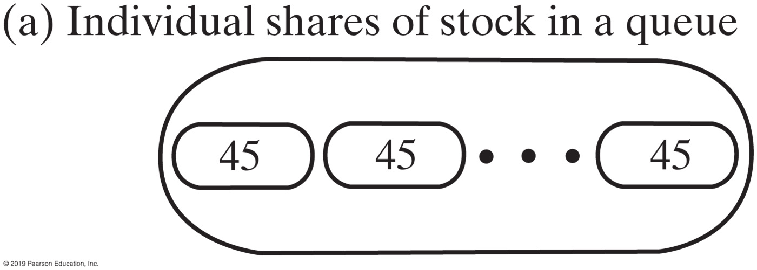
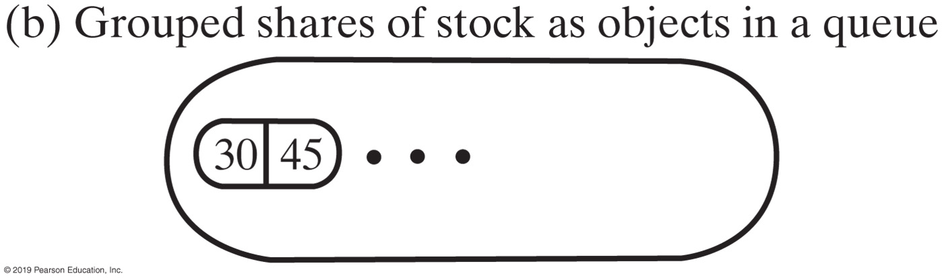
FIGURE 7-9 Two representations of stock shares in a queue
FIGURE 7-9 Two representations of stock shares in a queue

Slide 22
Java Class Library: The Interface Queue
Methods provided
add
offer
remove
poll
element
peek
isEmpty
size

Slide 23
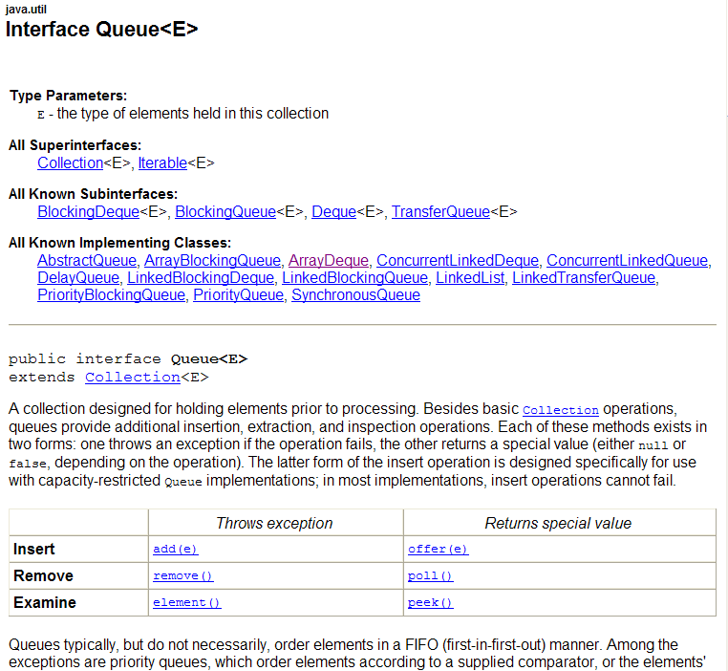

Slide 24
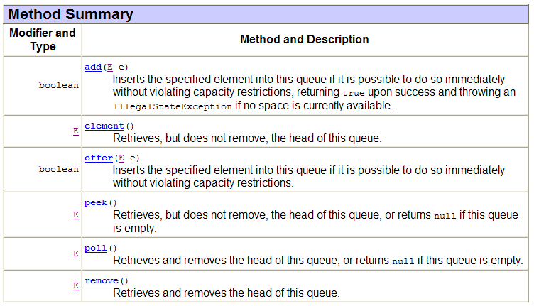

Slide 25
The ADT Deque
A double ended queue
Deque pronounced “deck”
Has both queue-like operations and stack-like operations

Slide 26
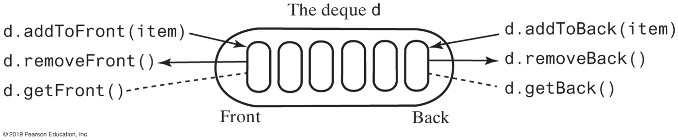
The ADT Deque
FIGURE 7-10 An instance d of a deque

Slide 27
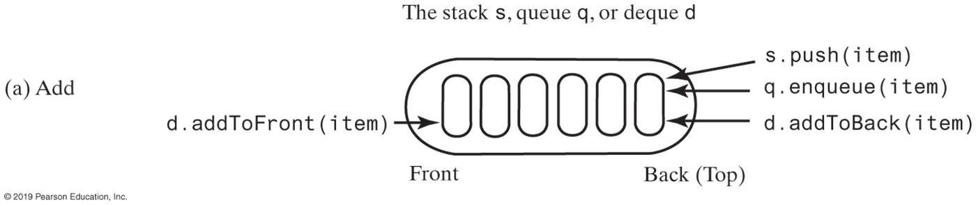
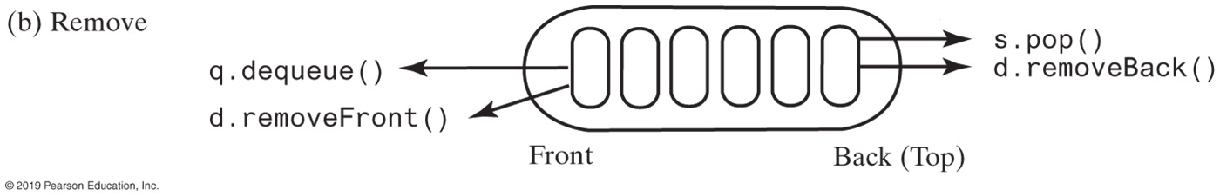
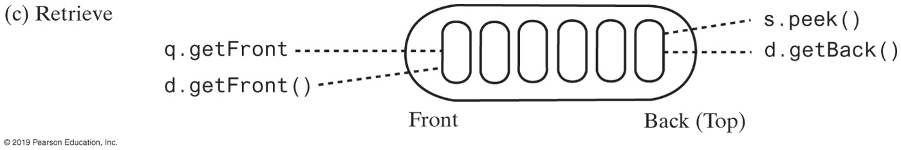
FIGURE 7-11 A comparison of operations for a stack s, a queue q, and a deque d
FIGURE 7-11 A comparison of operations for a stack s, a queue q, and a deque d

Slide 28
The ADT Deque
/** An interface for the ADT deque. */
public interface DequeInterface<T>
{
/** Adds a new entry to the front/back of this deque.
@param newEntry An object to be added. */
public void addToFront(T newEntry);
public void addToBack(T newEntry);
/** Removes and returns the front/back entry of this deque.
@return The object at the front/back of the deque.
@throws EmptyQueueException if the deque is empty before the
operation. */
public T removeFront();
public T removeBack();
/** Retrieves the front/back entry of this deque.
@return The object at the front/back of the deque.
@throws EmptyQueueException if the deque is empty. */
public T getFront();
public T getBack();
/** Detects whether this deque is empty.
@return True if the deque is empty, or false otherwise. */
public boolean isEmpty();
/* Removes all entries from this deque. */
public void clear();
} // end DequeInterface
LISTING 7-4 An interface for the ADT deque

Slide 29
The ADT Deque
// Read a line
d = a new empty deque
while (not end of line)
{
character = next character read
if (character == ←)
d.removeBack()
else
d.addToBack(character)
}
// Display the corrected line
while (!d.isEmpty())
System.out.print(d.removeFront())
System.out.println()
Pseudocode that uses a deque to read and display a line of keyboard input

Slide 30
Computing the Capital Gain in a Sale of Stock
public double sell(int sharesSold, double pricePerShare)
{
double saleAmount = sharesSold * pricePerShare;
double totalCost = 0;
while (sharesSold > 0)
{
StockPurchase transaction = ledger.removeFront();
double shareCost = transaction.getCostPerShare();
int numberOfShares = transaction.getNumberOfShares();
if (numberOfShares > sharesSold)
{
totalCost = totalCost + sharesSold * shareCost;
int numberToPutBack = numberOfShares - sharesSold;
StockPurchase leftOver = new StockPurchase(numberToPutBack, shareCost);
ledger.addToFront(leftOver); // Return leftover shares
// Note: Loop will exit since sharesSold will be <= 0 later
}
else
totalCost = totalCost + numberOfShares * shareCost;
sharesSold = sharesSold - numberOfShares;
} // end while
return saleAmount - totalCost; // Gain or loss
} // end sell
Method buy creates an instance of StockPurchase and places it at the back of the deque

Slide 31
Java Class Library: The Interface Deque
Methods provided
addFirst, offerFirst
addLast, offerLast
removeFirst, pollFirst
removeLast, pollLast
getFirst, peekFirst
getLast, peekLast
isEmpty, clear, size
push, pop

Slide 32
Java Class Library: The Class ArrayDeque
Implements the interface Deque
Constructors provided
ArrayDeque()
ArrayDeque(int initialCapacity)

Slide 33
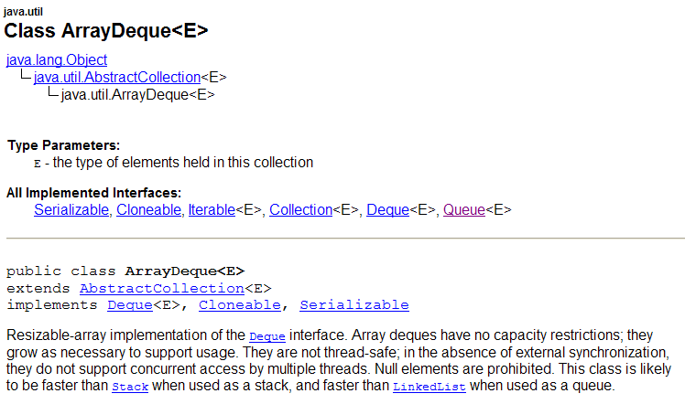
Java Class Library: The Class ArrayDeque

Slide 34
ADT Priority Queue
Consider how a hospital assigns a priority to each patient that overrides time at which patient arrived.
ADT priority queue organizes objects according to their priorities
Definition of “priority” depends on nature of the items in the queue

Slide 35
ADT Priority Queue
/** An interface for the ADT priority queue. */
public interface PriorityQueueInterface<T extends Comparable<? super T>>
{
/** Adds a new entry to this priority queue.
@param newEntry An object to be added. */
public void add(T newEntry);
/** Removes and returns the entry having the highest priority.
@return Either the object having the highest priority or, if the
priority queue is empty before the operation, null. */
public T remove();
/** Retrieves the entry having the highest priority.
@return Either the object having the highest priority or, if the
priority queue is empty, null. */
public T peek();
/** Detects whether this priority queue is empty.
@return True if the priority queue is empty, or false otherwise. */
public boolean isEmpty();
/** Gets the size of this priority queue.
@return The number of entries currently in the priority queue. */
public int getSize();
/** Removes all entries from this priority queue. */
public void clear();
} // end PriorityQueueInterface
LISTING 7-5 An interface for the ADT priority queue

Slide 36
Tracking Your Assignments
Assignment
course—the course code task—a description of the assignment date—the due date
getCourseCode() getTask() getDueDate() compareTo()
AssignmentLog
log—a priority queue of assignments
addProject(newAssignment) addProject(courseCode, task, dueDate) getNextProject() removeNextProject()
FIGURES 7-12 & 7-13 UML diagrams of the class Assignment and AssignmentLog

Slide 37
Tracking Your Assignments
public class AssignmentLog
{
private PriorityQueueInterface<Assignment> log;
public AssignmentLog()
{
log = new PriorityQueue<>();
} // end constructor
public void addProject(Assignment newAssignment)
{
log.add(newAssignment);
} // end addProject
public void addProject(String courseCode, String task, Date dueDate)
{
Assignment newAssignment = new Assignment(courseCode, task, dueDate);
addProject(newAssignment);
} // end addProject
public Assignment getNextProject()
{
return log.peek();
} // end getNextProject
public Assignment removeNextProject()
{
return log.remove();
} // end removeNextProject
} // end AssignmentLog
LISTING 7-6 The class AssignmentLog

Slide 38
Java Class Library: The Class PriorityQueue
Basic constructors and methods
PriorityQueue
add
offer
remove
poll
element
peek
isEmpty, clear, size

Slide 39
Java Class Library: The Class ArrayDeque

Slide 40
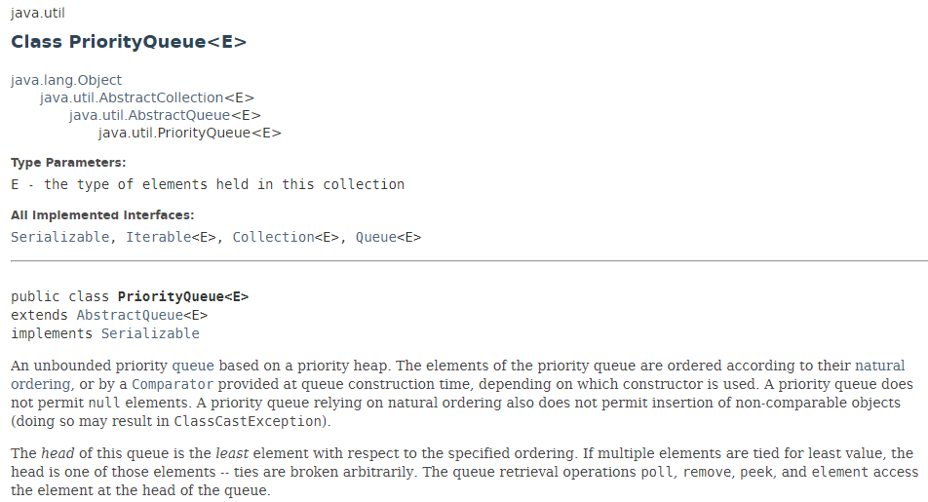
Java Class Library: The Class PriorityQueue

Slide 41
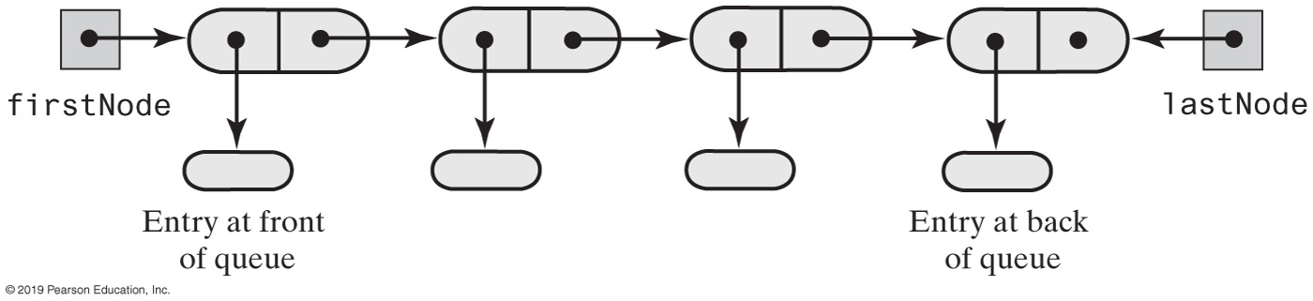
Linked Implementation of a Queue
FIGURE 8-1 A chain of linked nodes that implements a queue

Slide 42
Linked Implementation of a Queue
/** A class that implements a queue of objects by using
a chain of linked nodes that has both head and tail references. */
public final class LinkedQueue<T> implements QueueInterface<T>
{
private Node firstNode; // References node at front of queue
private Node lastNode; // References node at back of queue
public LinkedQueue()
{
firstNode = null;
lastNode = null;
} // end default constructor
// < Implementations of the queue operations go here. >
// . . .
private class Node
{
// < Implementation of the inner class Node goes here. >
} // end Node
} // end LinkedQueue
LISTING 8-1 An outline of a linked implementation of the ADT queue

Slide 43
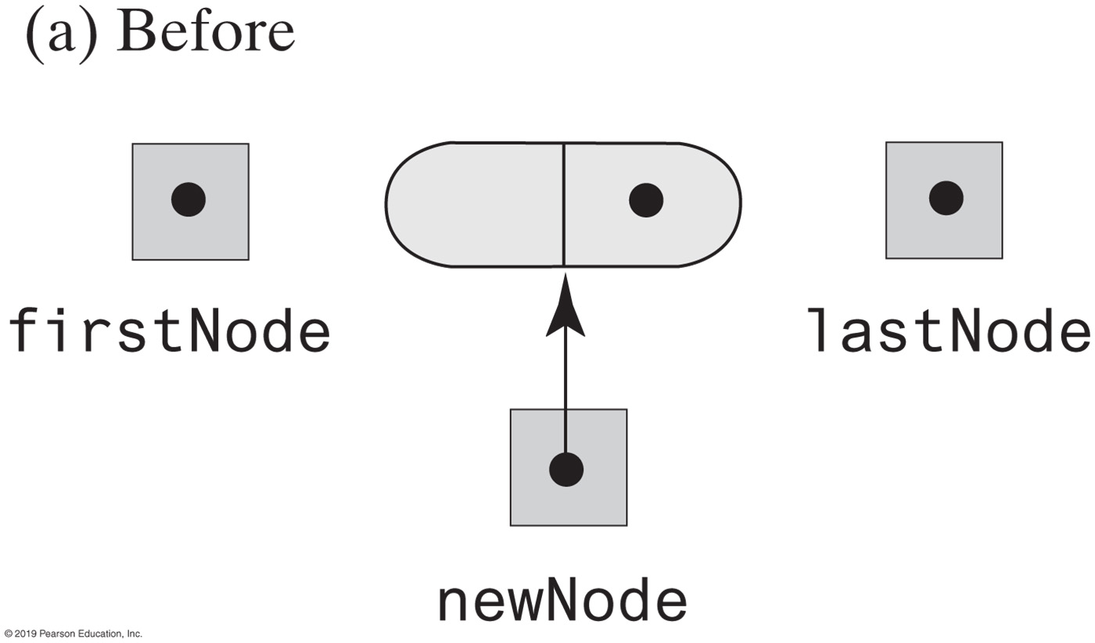
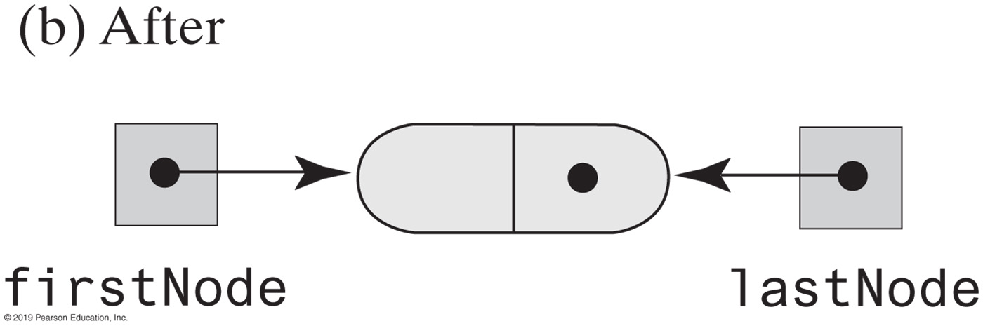
Linked Implementation of a Queue
FIGURE 8-2 Before and after adding a new node to an empty chain

Slide 44
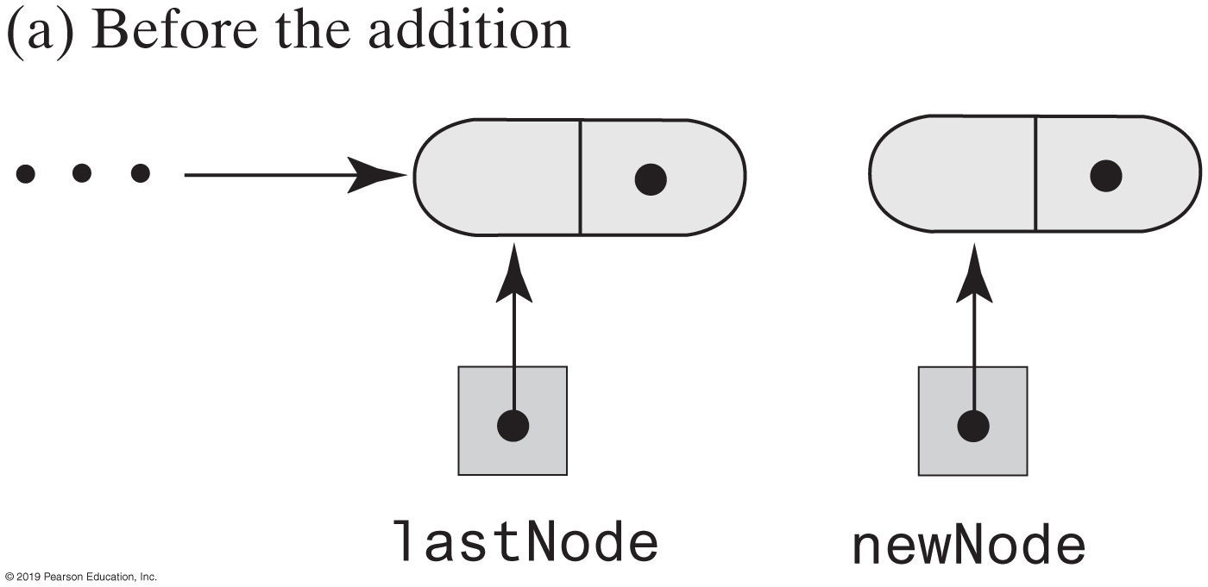
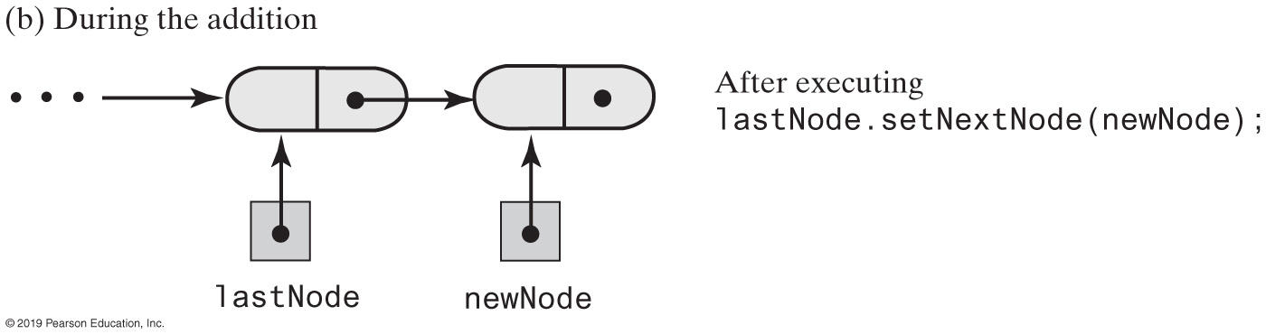
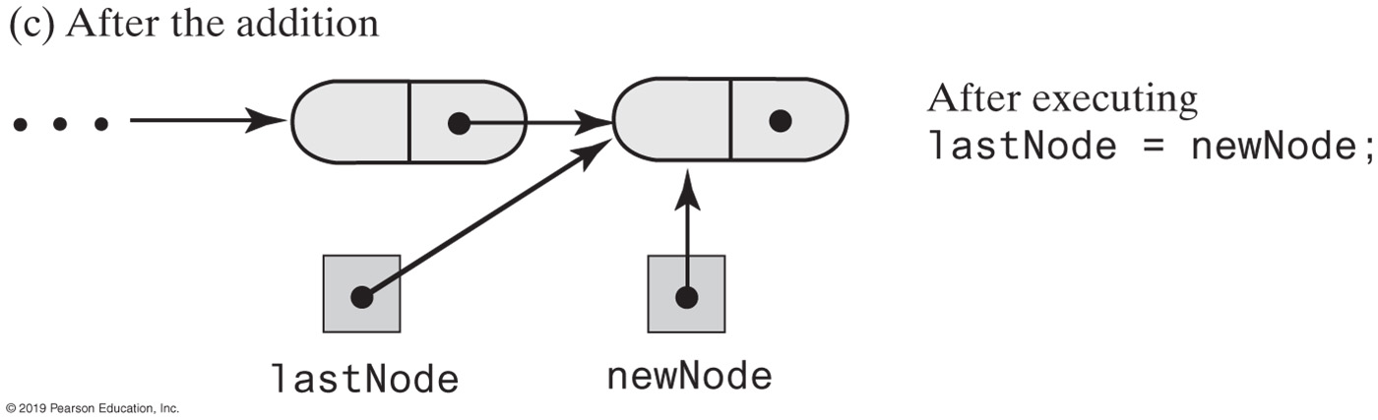
FIGURE 8-3 Adding a new node to the end of a nonempty chain that has a tail reference
FIGURE 8-3 Adding a new node to the end of a nonempty chain that has a tail reference

Slide 45
Linked Implementation of a Queue
public void enqueue(T newEntry)
{
Node newNode = new Node(newEntry, null);
if (isEmpty())
firstNode = newNode;
else
lastNode.setNextNode(newNode);
lastNode = newNode;
} // end enqueue
The definition of enqueue Performance is O(1)

Slide 46
Linked Implementation of a Queue
public T getFront()
{
if (isEmpty())
throw new EmptyQueueException();
else
return firstNode.getData();
} // end getFront
Retrieving the front entry

Slide 47
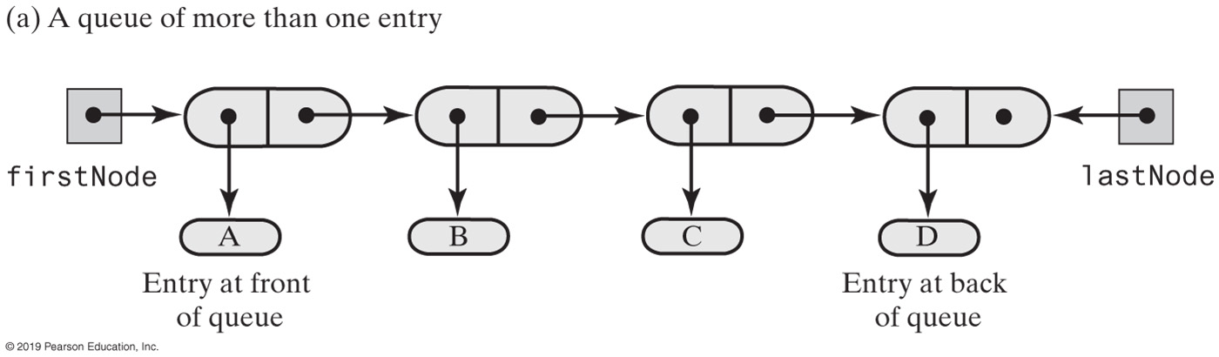
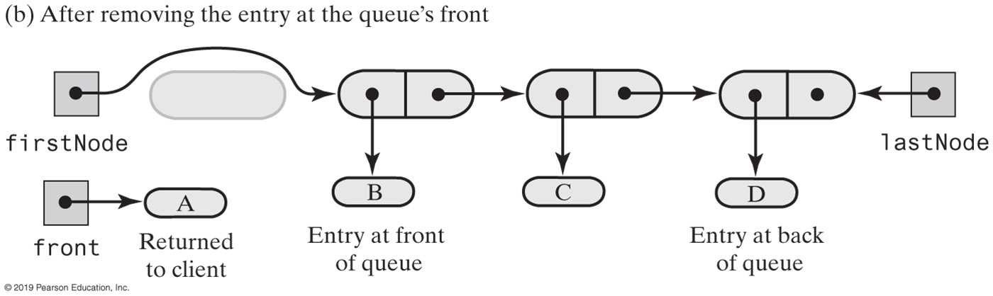
FIGURE 8-4 Before and after removing the entry at the front of a queue that has more than one entry
FIGURE 8-4 Before and after removing the entry at the front of a queue that has more than one entry

Slide 48
Linked Implementation of a Queue
public T dequeue()
{
T front = getFront(); // Might throw EmptyQueueException
// Assertion: firstNode != null
firstNode.setData(null);
firstNode = firstNode.getNextNode();
if (firstNode == null)
lastNode = null;
return front;
} // end dequeue
Removing the front entry

Slide 49
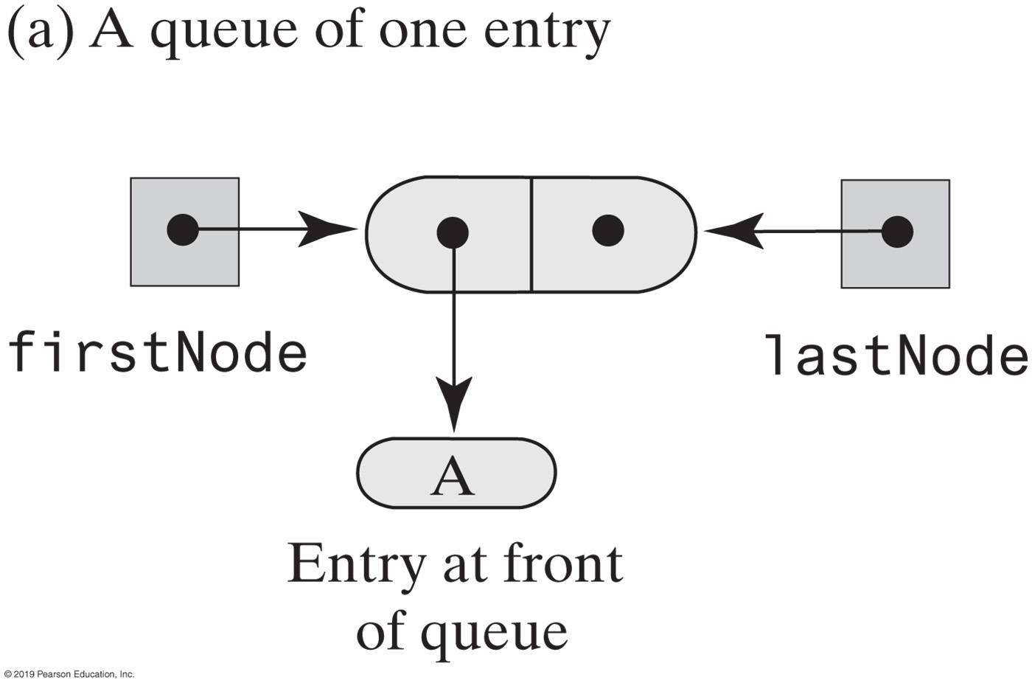
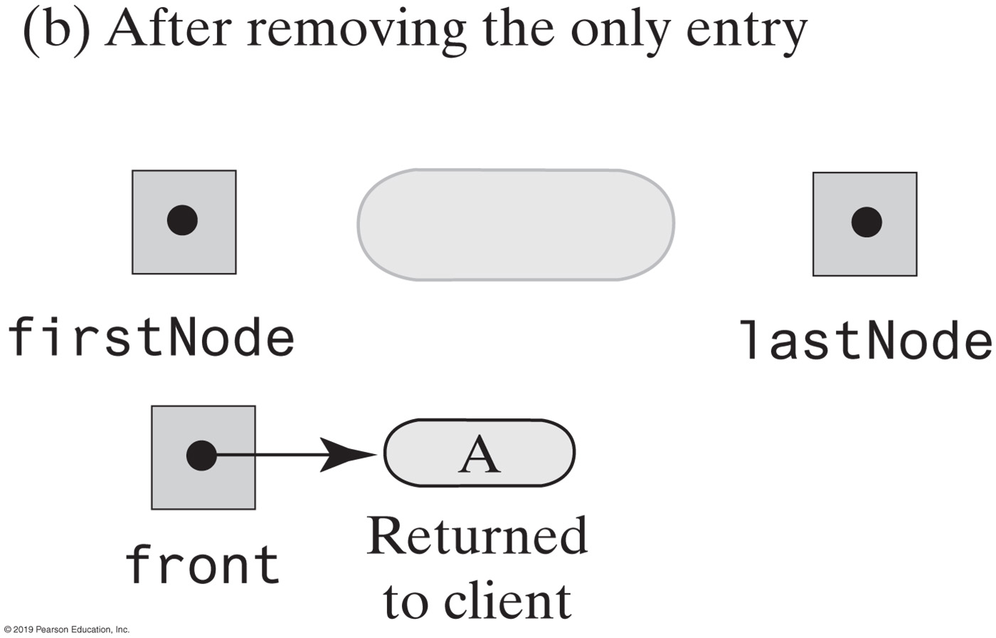
Linked Implementation of a Queue
FIGURE 8-5 Before and after removing the only entry from a queue

Slide 50
Linked Implementation of a Queue
public boolean isEmpty()
{
return (firstNode == null) && (lastNode == null);
} // end isEmpty
public void clear()
{
firstNode = null;
lastNode = null;
} // end clear
Public methods isEmpty and clear

Slide 51
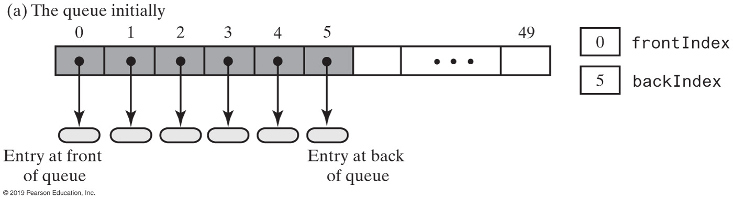
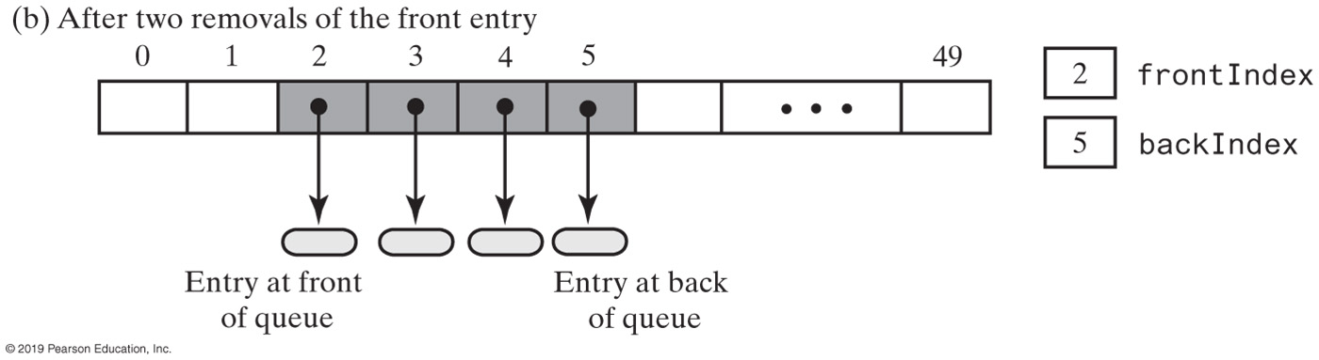
Array-Based Implementation of a Queue: Circular Array
FIGURE 8-6 An array that represents a queue without moving any entries during additions and removals

Slide 52
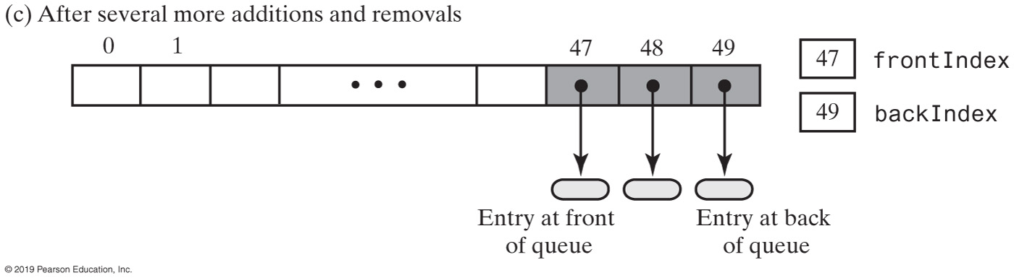
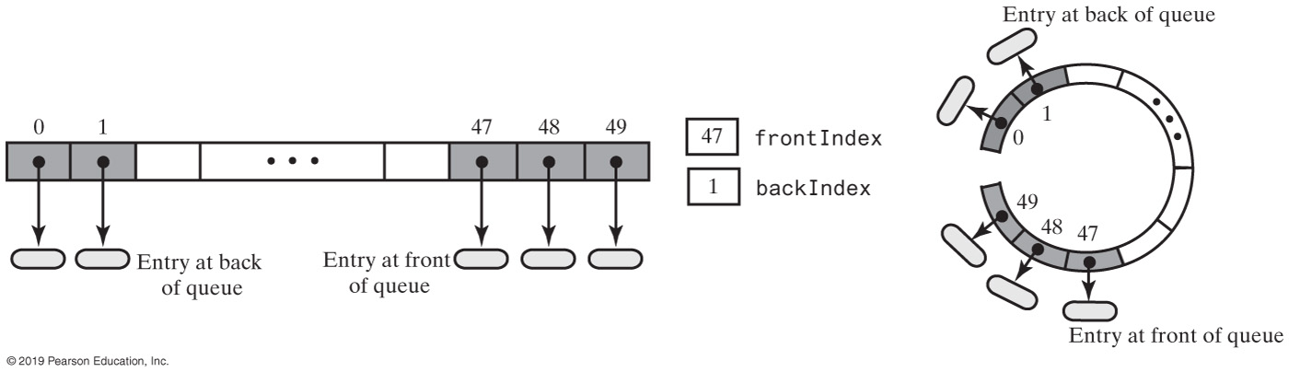
Circular Array
FIGURE 8-7 A circular array that represents the queue in Figure 8-6c after adding two more entries

Slide 53
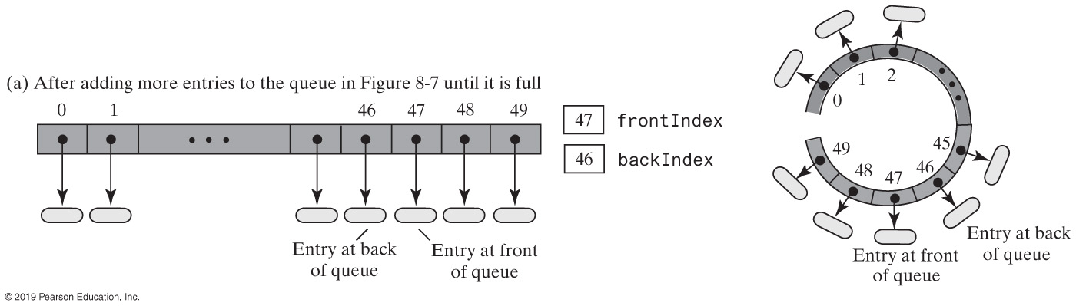
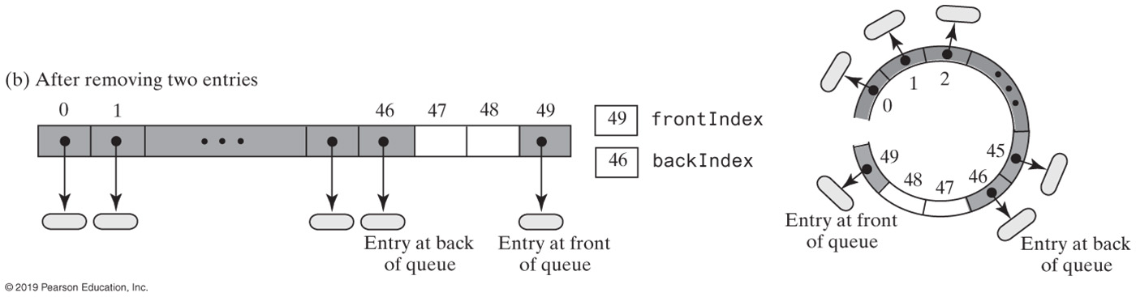
Circular Array
FIGURE 8-8a&b A circular array representation of a queue as entries are removed

Slide 54
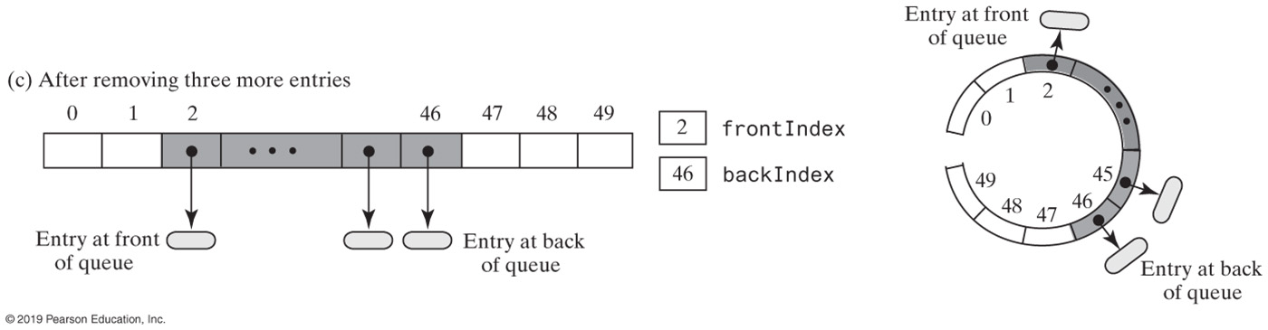
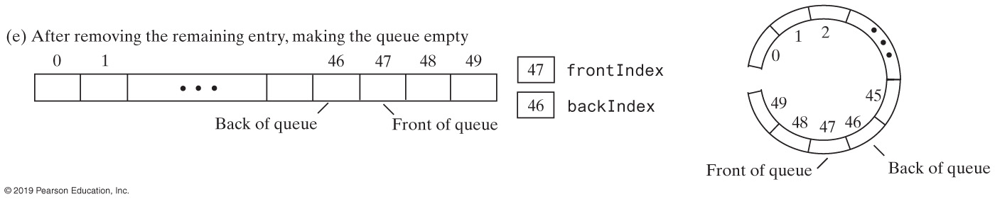
Circular Array
FIGURE 8-8c&d A circular array representation of a queue as entries are removed

Slide 55
Circular Array with One Unused Location
public T getFront()
{
checkIntegrity();
if (isEmpty())
throw new EmptyQueueException();
else
return queue[frontIndex];
} // end getFront
Retrieving the front entry

Slide 56
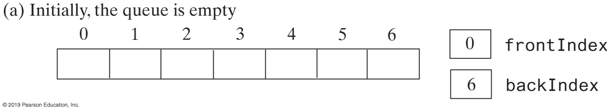
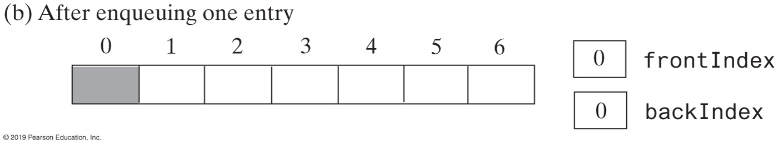
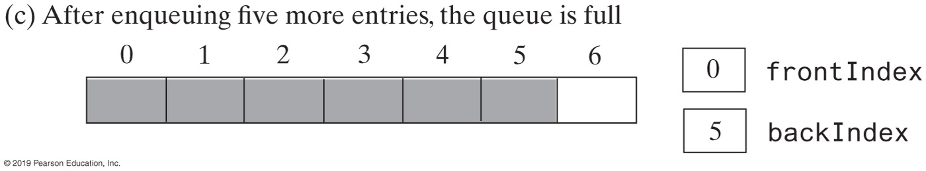
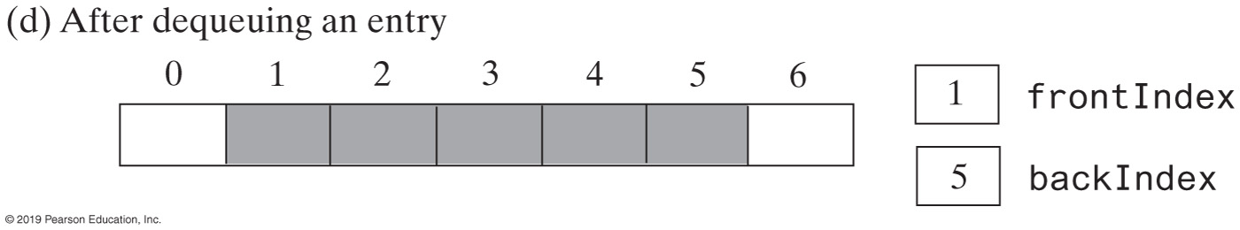
Circular Array (Part 1)
FIGURE 8-9 A seven-element circular array that contains at most six entries of a queue

Slide 57
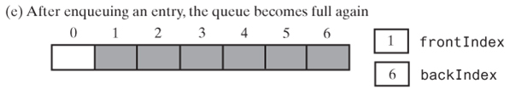
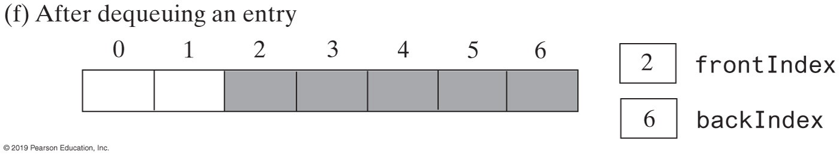
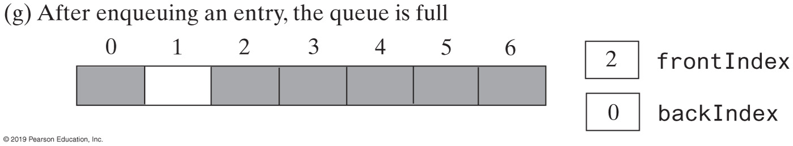
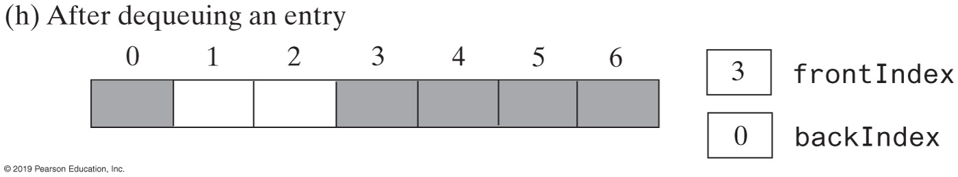
Circular Array (Part 2)
FIGURE 8-9 A seven-element circular array that contains at most six entries of a queue

Slide 58
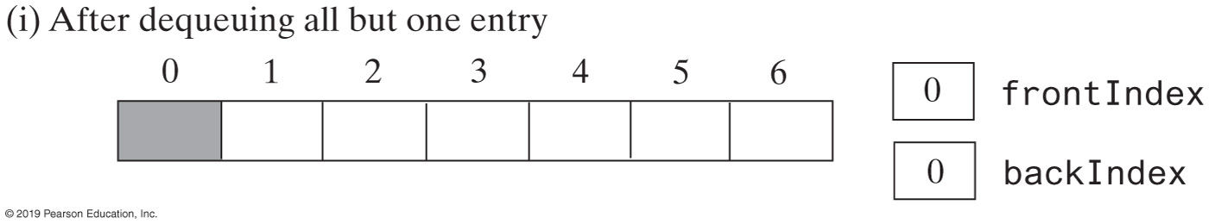
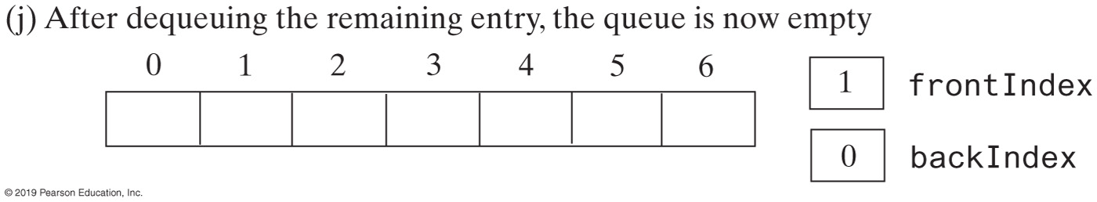
Circular Array (Part 3)
FIGURE 8-9 A seven-element circular array that contains at most six entries of a queue

Slide 59
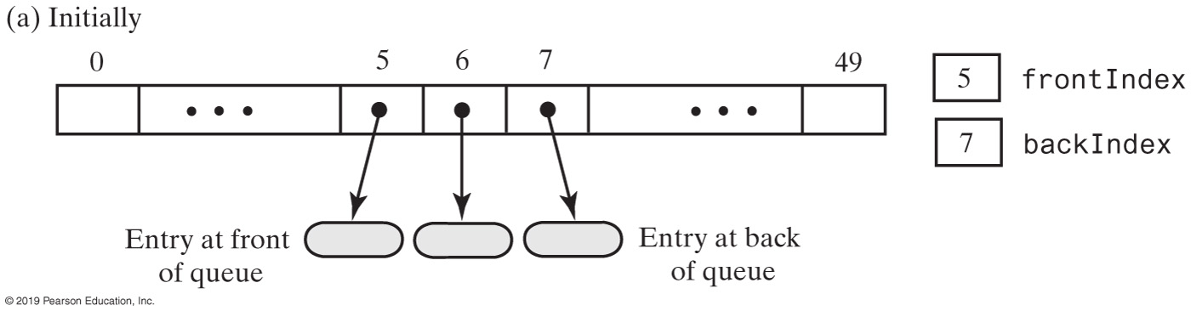
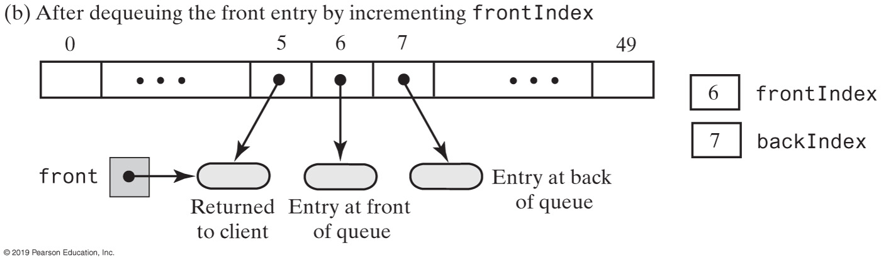
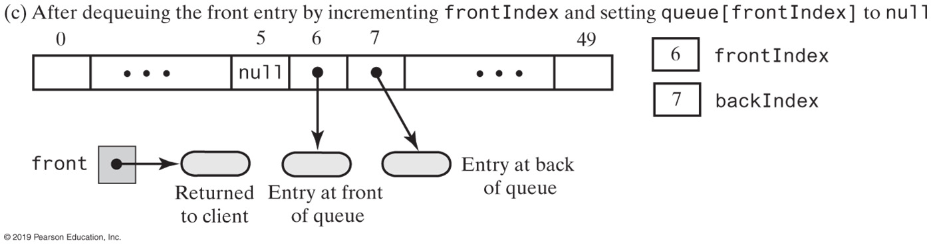
Circular Array with One Unused Location
FIGURE 8-10 An array-based queue and two ways to remove its front entry

Slide 60
Circular Array with One Unused Location
public T dequeue()
{
checkIntegrity();
if (isEmpty())
throw new EmptyQueueException();
else
{
T front = queue[frontIndex];
queue[frontIndex] = null;
frontIndex = (frontIndex + 1) % queue.length;
return front;
} // end if
} // end dequeue
Implementation of dequeue

Slide 61
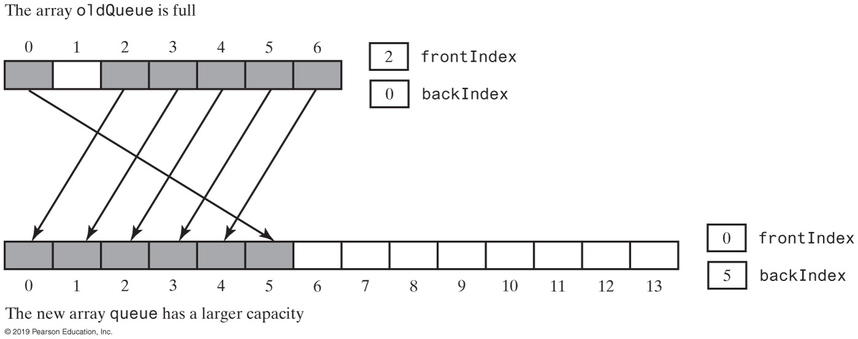
Circular Array with One Unused Location
FIGURE 8-11 Doubling the size of an array-based queue

Slide 62
Circular Array with One Unused Location
// Doubles the size of the array queue if it is full.
// Precondition: checkIntegrity has been called.
private void ensureCapacity()
{
if (frontIndex == ((backIndex + 2) % queue.length)) // If array is full,
{ // double size of array
T[] oldQueue = queue;
int oldSize = oldQueue.length;
int newSize = 2 * oldSize;
checkCapacity(newSize);
integrityOK = false;
// The cast is safe because the new array contains null entries
@SuppressWarnings("unchecked")
T[] tempQueue = (T[]) new Object[newSize];
queue = tempQueue;
for (int index = 0; index < oldSize - 1; index++)
{
queue[index] = oldQueue[frontIndex];
frontIndex = (frontIndex + 1) % oldSize;
} // end for
frontIndex = 0;
backIndex = oldSize - 2;
integrityOK = true;
} // end if
} // end ensureCapacity
Definition of ensureCapacity

Slide 63
Circular Array with One Unused Location
public boolean isEmpty()
{
checkIntegrity():
return frontIndex == ((backIndex + 1) % queue.length);
} // end isEmpty
Implementation of isEmpty

Slide 64
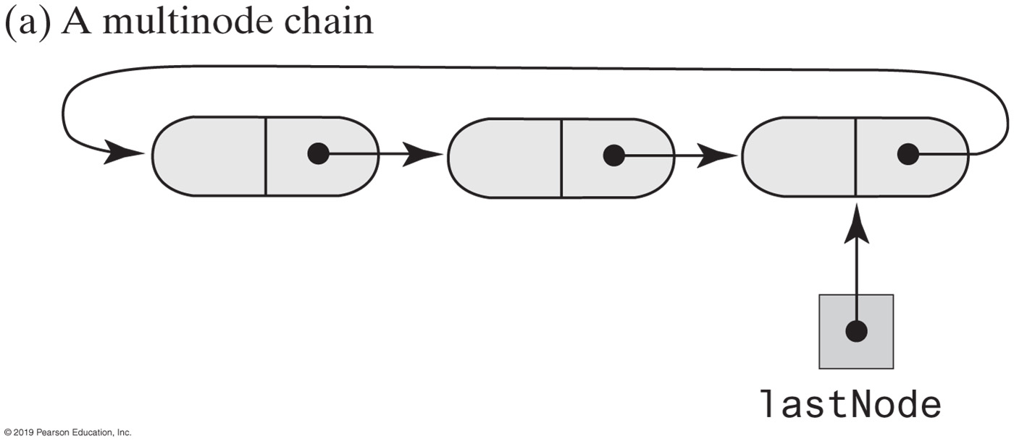
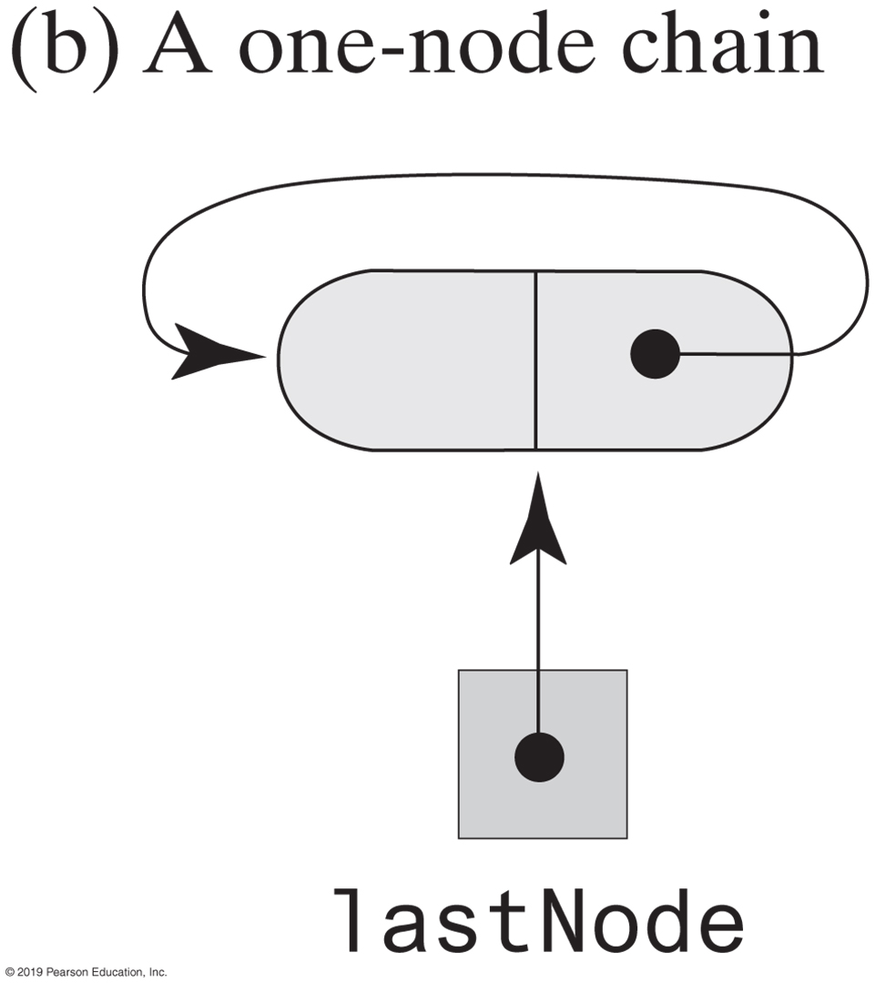
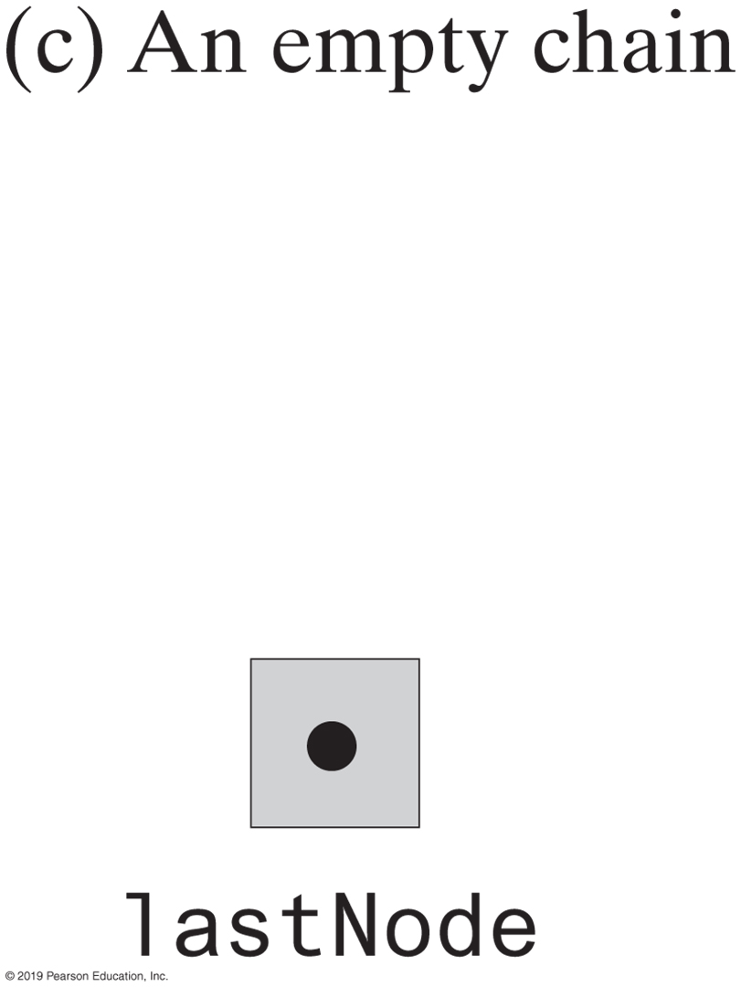
Circular Linked Implementations of a Queue
FIGURE 8-12 Circular linked chains, each with an external reference to its last node

Slide 65

Two-Part Circular Linked Chain
FIGURE 8-13 A two-part circular linked chain that represents both a queue and the nodes available to the queue

Slide 66





Two-Part Circular Linked Chain
FIGURE 8-14 Various states of a two-part circular linked chain that represents a queue

Slide 67
Two-Part Circular Linked Chain
/** A class that implements the ADT queue by using
a two-part circular chain of linked nodes. */
public final class TwoPartCircularLinkedQueue<T> implements QueueInterface<T>
{
private Node queueNode; // References first node in queue
private Node freeNode; // References node after back of queue
public TwoPartCircularLinkedQueue()
{
freeNode = new Node(null, null);
freeNode.setNextNode(freeNode);
queueNode = freeNode;
} // end default constructor
// < Implementations of the queue operations go here. >
// . . .
private class Node
{
// < Implementation of the nine Node class god here. >
} // end Node
} // end TwoPartCircularLinkedQueue
LISTING 8-3 An outline of a two-part circular linked implementation of the ADT queue

Slide 68


Two-Part Circular Linked Chain
FIGURE 8-15a A two-part circular chain that requires a new node for an addition to a queue

Slide 69



Two-Part Circular Linked Chain
FIGURE 8-16 A two-part circular linked chain with nodes available for addition to a queue

Slide 70
Two-Part Circular Linked Chain
public void enqueue(T newEntry)
{
freeNode.setData(newEntry);
if (isNewNodeNeeded())
{
// Allocate a new node and insert it after the node that
// freeNode references
Node newNode = new Node(null, freeNode.getNextNode());
freeNode.setNextNode(newNode);
} // end if
freeNode = freeNode.getNextNode();
} // end enqueue
Implementation of enqueue is an O(1) operation

Slide 71
Two-Part Circular Linked Chain
public T getFront()
{
if (isEmpty())
throw new EmptyQueueException();
else
return queueNode.getData();
} // end getFront
Implementation of getFront is an O(1) operation

Slide 72
Two-Part Circular Linked Chain
public T dequeue()
{
T front = getFront(); // Might throw EmptyQueueException
// Assertion: Queue is not empty
queueNode.setData(null);
queueNode = queueNode.getNextNode();
return front;
} // end dequeue
Implementation of dequeue is an O(1) operation

Slide 73
Two-Part Circular Linked Chain
public boolean isEmpty()
{
return queueNode == freeNode;
} // end isEmpty
private boolean isNewNodeNeeded()
{
return queueNode == freeNode.getNextNode();
} // end isNewNodeNeeded
Methods isEmpty an isNewNodeNeeded

Slide 74
Java Class Library: The Class AbstractQueue
public boolean add(T newEntry)
public boolean offer(T newEntry)
public T remove()
public T poll()
public T element()
public T peek()
public boolean isEmpty()
public void clear()
public int size()
Methods in this interface

Slide 75

Doubly Linked Implementation of a Deque
FIGURE 8-17 A doubly linked chain with head and tail references

Slide 76
Doubly Linked Implementation of a Deque
/** A class that implements the a deque of objects by using
a chain of doubly linked nodes. */
public final class LinkedDeque<T> implements DequeInterface<T>
{
private DLNode firstNode; // References node at front of deque
private DLNode lastNode; // References node at back of deque
public LinkedDeque()
{
firstNode = null;
lastNode = null;
} // end default constructor
// < Implementations of the deque operations go here. >
// . . .
private class DLNode
{
private T data; // Deque entry
private DLNode next; // Link to next node
private DLNode previous; // Link to previous node
// < Constructors and the methods getData, setData, getNextNode, setNextNode,
// getPreviousNode, and setPreviousNode are here. >
// . . .
} // end DLNode
} // end LinkedDeque
LISTING 8-4 An outline of a linked implementation of the ADT deque

Slide 77


Doubly Linked Implementation of a Deque
FIGURE 8-18 Adding to the back of a nonempty deque

Slide 78
Doubly Linked Implementation of a Deque
public void addToBack(T newEntry)
{
DLNode newNode = new DLNode(lastNode, newEntry, null);
if (isEmpty())
firstNode = newNode;
else
lastNode.setNextNode(newNode);
lastNode = newNode;
} // end addToBack
LISTING 8-4 An outline of a linked implementation of the ADT deque

Slide 79


FIGURE 8-19a Adding to the front of a nonempty deque
FIGURE 8-19 Adding to the front of a nonempty deque

Slide 80
Doubly Linked Implementation of a Deque
public void addToFront(T newEntry)
{
DLNode newNode = new DLNode(null, newEntry, firstNode);
if (isEmpty())
lastNode = newNode;
else
firstNode.setPreviousNode(newNode);
firstNode = newNode;
} // end addToFront
Implementation of addToFront, an O(1) operation.

Slide 81


Doubly Linked Implementation of a Deque
FIGURE 8-20 Removing the front of a deque containing at least two entries

Slide 82
Doubly Linked Implementation of a Deque
public T removeFront()
{
T front = getFront(); // Might throw EmptyQueueException
// Assertion: firstNode != null
firstNode = firstNode.getNextNode();
if (firstNode == null)
lastNode = null;
else
firstNode.setPreviousNode(null);
return front;
} // end removeFront
Implementation of removeFront.

Slide 83
Doubly Linked Implementation of a Deque
public T removeBack()
{
T back = getBack(); // Might throw EmptyQueueException
// Assertion: lastNode != null
lastNode = lastNode.getPreviousNode();
if (lastNode == null)
firstNode = null;
else
lastNode.setNextNode(null);
} // end if
return back;
} // end removeBack
Implementation of removeBack, an O(1) operation.

Slide 84


Possible Implementations of a Priority Queue
FIGURE 8-21 Two possible implementations of a priority queue

